Slide 1
Data Cleaning
Data 100
Slides adapted from Josh Hug, Joey Gonzalez, Deb Nolan, Fernando Perez, & Joe Hellerstein

Slide 2
Announcements

Slide 3
Groupby & Pivot
(Demo)

Slide 4
Series groupby/agg Summary
groupby
.agg(f), where f = sum
A
3
A
3
A
1
B
1
A
2
C
4
B
1
A
1
A
6
B
5
B
5
B
12
B
6
C
9
C
13
A
2
C
4
D
5
D
5
C
9
B
6
D
5

Slide 5
DataFrame groupby/agg Summary
groupby
.agg(f), where f = max
A
3
ak
A
3
ak
A
1
hi
B
1
tx
A
2
ca
C
4
fl
A
1
hi
B
1
tx
A
3
hi
B
5
mi
B
5
mi
B
6
tx
C
9
ak
B
6
nc
C
9
sd
A
2
ca
C
4
fl
C
5
sd
C
9
ak
B
6
nc
C
5
sd

Slide 6
Series groupby/filter Summary
groupby
.filter(f), where
f = lambda sf: sf[“num”].sum() > 10
A
3
A
3
A
1
B
1
A
2
6
C
4
B
1
B
1
C
4
A
1
B
5
12
B
5
B
5
B
6
C
9
C
9
13
A
2
B
6
C
4
D
5
C
9
5
B
6
D
5

Slide 7
Pivot Tables
R
C
A
U
3
f
A
U
3
A
U
5
A
U
2
B
V
1
f
A
V
1
A
V
1
U
V
C
U
4
f
B
U
5
B
U
5
A
5
1
A
V
1
group
B
V
1
...
B
5
7
B
U
5
f
B
V
7
B
V
6
C
4
9
C
V
9
f
D
5
NaN
A
U
2
C
U
4
C
U
4
D
U
5
f
C
V
9
C
V
9
B
V
6
f
D
U
5
D
U
5

Slide 8
Data Cleaning

Slide 9
What is Data Cleaning?
The process of transforming raw data to facilitate subsequent analysis.
Data cleaning often addresses:
Structure of the data
Encoding and/or formatting of values (e.g., strings vs numbers)
Missing and/or corrupted values
Unit conversion and interpretation of magnitudes
Extracting features of complex values (e.g., the year from a timestamp)
Data cleaning is a time-consuming but critical part of data science
Data cleaning is often a reaction to other stages of the data science lifecycle:
Exploratory data analysis identifies issues with the raw data.
Surprising inferential results might be due to misinterpreted or bad data.
New hypotheses or questions prompt an investigation some aspect of data.

Slide 10
Rectangular Data
Rectangular data sets are easy to manipulate, visualize, and combine.
Tables (DataFrames):
Each labeled column has values of the same type.
Manipulated using group, sort, join, etc.
Formal description of data transformations is called relational algebra.
Matrices:
All values have the same type.
Manipulated using multiplication, addition, and element-wise operations.
Most useful manipulation is linear, described by linear algebra.
A lot of data cleaning effort is spent making data more rectangular.

Slide 11
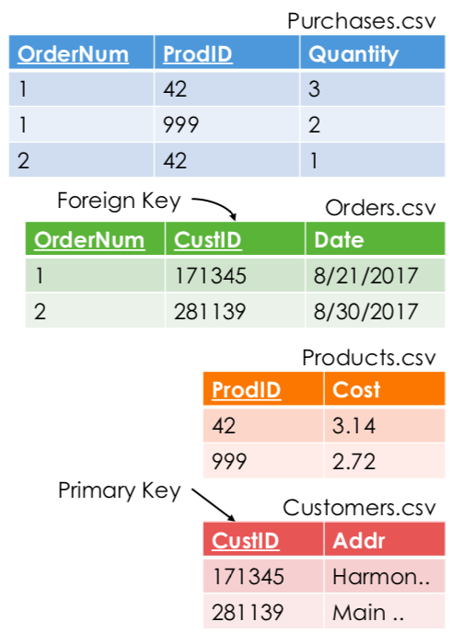
Keys
Primary key: the column (or set of columns) that determines the values in the remaining columns.
Unique for each row & 1-to-1 with entities.
Ensures that the row can be identified, even after appending more data. E.g., SSN
Foreign key: a column containing values that are primary keys for other rows.
A foreign key serves as a reference to a row.
Joining tables expands the reference with values from the referenced row.
The referenced row can be in the same table or a different table.
Is an email address a good primary key?

Slide 12
Data File Formats

Slide 13
Comma-Separated Values
pandas.pydata.org/pandas-docs/stable/reference/api/pandas.read_csv.html
pandas.read_csv(filepath_or_buffer, sep=', ', delimiter=None, header='infer', names=None, index_col=None, usecols=None, squeeze=False, prefix=None, mangle_dupe_cols=True, dtype=None, engine=None, converters=None, true_values=None, false_values=None, skipinitialspace=False, skiprows=None, skipfooter=0, nrows=None, na_values=None, keep_default_na=True, na_filter=True, verbose=False, skip_blank_lines=True, parse_dates=False, infer_datetime_format=False, keep_date_col=False, date_parser=None, dayfirst=False, iterator=False, chunksize=None, compression='infer', thousands=None, decimal=b'.', lineterminator=None, quotechar='"', quoting=0, doublequote=True, escapechar=None, comment=None, encoding=None, dialect=None, tupleize_cols=None, error_bad_lines=True, warn_bad_lines=True, delim_whitespace=False, low_memory=True, memory_map=False, float_precision=None)

Slide 14
Reading CSV Files
Sometimes the first line contains column labels: header=’infer’ (default)
Other times you need to provide your own labels: header=None
Reasonable labels come from inspecting the data or reading the docs.
Don’t accidentally skip the first row of data by interpreting it as a header.
From the docs: “The header can be a list of integers that specify row locations for a multi-index on the columns, e.g. [0, 1, 3]. Intervening rows that are not specified will be skipped (e.g. 2 in this example is skipped).”

Slide 15
JSON, XML, HTML, YAML, Protocol Buffers, etc.
(Demo)
There are many formats to represent structured, hierarchical data.
Most formats consist of values, lists, and dictionaries.
Dictionaries are typically keyed by strings, but sometimes by integers.
Structures vary: a list of records, a list of columns, a tree of documents, etc.
Converting hierarchical data to rectangular data often involves keys.
To represent a tree: a column for the node ID & a column for the parent ID
To represent a graph: one table for nodes; one table for edges
In general, traverse the data and yield lists of values (rows).

Slide 16
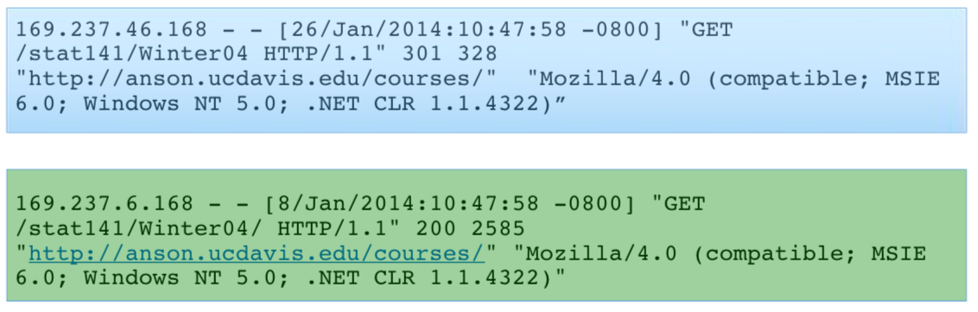
Log Files

Slide 17
Missing Values

Slide 18
What to do with Missing Values
(Demo)
Often, rectangular data sets have missing values:
A field of a record was lost, hidden, removed, replaced, or never entered.
The entity described by a record does not have a particular attribute. E.g., some people don’t have a permanent address.
How to treat missing values depends on goals, context, and consequences.
Discarding whole records (because of missing values) results in a sample.
That sample isn’t a random sample, so statistical inference is inappropriate.
The sample will often be biased — not representative of the population.
Replacing missing values within records has consequences for analysis.
If possible, replace missing values with the true value that was removed.
When imputing values, document the change and consider the effect. E.g., replacing missing values with the mean will decrease the variance.

Slide 19
Joins
(Demo)

